Slide 1
Arrays

Slide 2
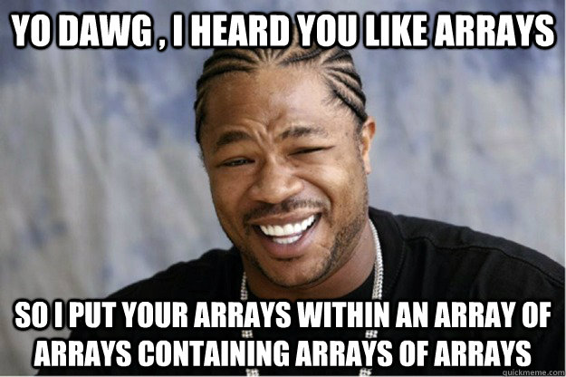
Arrays in Java
TOPICS
Declaration & Use
One Dimensional Arrays
Using Arrays & Elements
Searching an Array
Sorting an Array

Slide 3
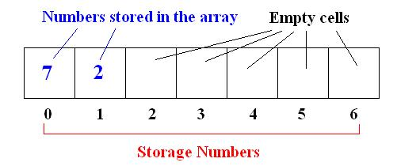
Intro
An array is a group of variables of the same type, stored in a single collection.
Allocated as contiguous memory
It is not a data type, but a data structure.
An array is referred to by a name, and must be declared in order to exist.

Slide 4
Intro
An array can contain any data type, but can only contain one type.
An array can have almost any number of elements.

Slide 5
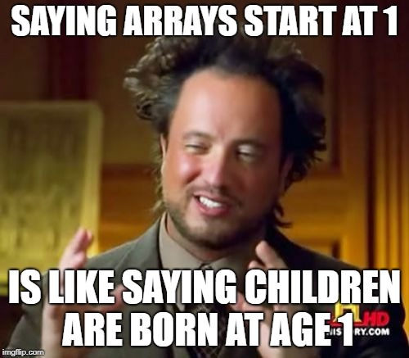
Intro
An entry in the array is referenced by using the array index.
Indices (plural for index) begin at 0 and continue until the end of the array.
An array of size n has n elements and an index of 0 to n-1.
What are the size, and index of this array?

Slide 6
Declaring an Array
Arrays can be declared in a couple different ways:
Most commonly:
type[ ] arrayName;
or
int[ ] scores;
This is ONLY a declaration. The array ‘scores’ still has a value of null.
Note: int scores[ ] is also a valid declaration but I think it looks dumb so I use the other one.

Slide 7
Declaring an Array
For Java to create our array in memory, we have to give it a size.
Usually, the size of the array is given when it is declared.
int[ ] intArray = new int[10];
This will create an integer array that can hold 10 elements.

Slide 8
Declaring an Array
If the array is already declared, giving it a size looks like this:
intArray = new int[10];
This will also create an array of size 10. Make sure the array is declared first though.

Slide 9
Declaring an Array
When an array is given a size, we say it has been instantiated. That means it has been allocated memory.
When an array is instantiated, all of its elements are set to a default value (0, false, null etc.)

Slide 10
Declaring an Array
Array declaration examples:
double[ ] prices = new double[100];
boolean[ ] flags = new boolean[5];
int[ ] numbers;
numbers = new int[42];

Slide 11
Array initialization
When an array is populated (given values), we say it is initialized. That means it is in its initial state.
The most straightforward way to populate an array is to hard-code it like this: int[ ] intArray = new int[ ]{1,3,4,2,5,3,7,8};
Java will then make an array of size 8 and fill the indices with the integers you provided.

Slide 12
Array initialization
In the newer versions of Java, when we initialize an array by hard-coding the values, we don’t have to use the ‘new’ operator.
So this: int[ ] intArray = new int[ ]{1,3,4,2,5,3,7,8};
becomes this: int[ ] intArray = {1,3,4,2,5,3,7,8};
We also don’t have to give it a size; Java can count really well.
What is the code to declare and initialize this array?

Slide 13
Accessing Array Elements
We access an element in an array through its index, placed inside square brackets.
Oh yes, ALL array indices start at zero.
Examples:
int myInt = intArray[0], System.out.println(intArray[4]);

Slide 14
Accessing Array Elements
When accessing an array element, we can use / treat it like the variable type that it is.
Example: if((intArray[0] + intArray[3]) > 50)
{ //do stuff
}

Slide 15
Processing Arrays
Often, a for loop is used to process / print an arrays elements.
The loop control variable -i- is used as the index to access array elements.
We use a method which belongs to arrays to check the size of the array.
Example:
for(int i = 0; i < myArray.length(); i++)
{
System.out.println(myArray[i]);
sum = sum + myArray[i];
}

Slide 16
Exercise
Write a method that…
Created a string array with 5 elements
Initialize each element with one word in the phrase “This is a string array”
Use a for loop to print each element of the array

Slide 17
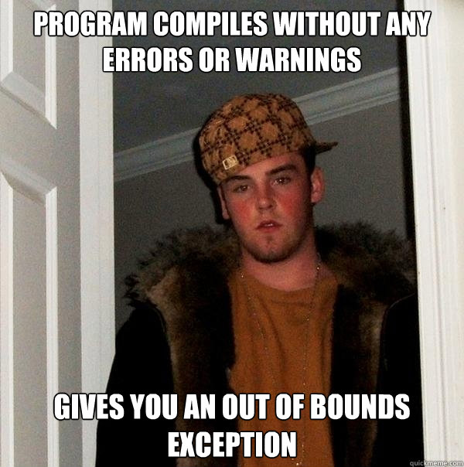
Bounds Checking
Once an array is instantiated, its size can’t be changed.
If you try to access an index that is outside of the array, you will get an incredibly annoying error known as an
“ArrayIndexOutOfBoundsException”
If you get this error, it means you’ve gone past the bounds of the array.

Slide 18
Bounds Checking
Example: if an integer array named “scores” has a size of 10, its indices range from 0 to 9.
If you try to access index 10, 11 or more, you will get the “OutOfBounds” error.
Example:
for(i = 0; i < 11; i++)
{
sum = sum + scores[i];
}

Slide 19
Passing Arrays
Just like a primitive data type, arrays can be passed to or returned from methods.
We just have to make sure the method header specifies an array as a parameter OR that the method’s return type is an array.
Examples:
public int[ ] methodName() public void name(double[ ] num)
{ { //method has double array as
//method returns an int array //a parameter
} }

Slide 20
Practice Exercise
The temperature of Winnipeg is recorded over a week: 8,5,10,9,3,1,5
Place the values into an integer array.
Write code to print out the temperatures for the week, and to print out the highest temperature for the week.
Example output:
Temperatures for the week are as follows: 8,5,10,9,3,1,5.
The highest temperature for the week was: 10 degrees.

Slide 21
Sorting Arrays
Sorting arrays involves placing their elements in a particular order, according to a certain criteria.
This may make the array easier to work with or make it easier to view the data, depending on the data type contained in the array.
Examples: integers: lowest to highest, characters: alphabetical, Strings: length, Objects: depends on the type.

Slide 22
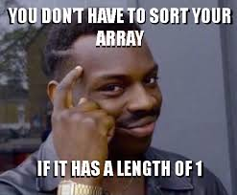
Sorting Arrays
Arrays are sorted using algorithms.
An algorithm is a process or set of rules to be followed when performing calculations (or problem solving).
There are many different sorting algorithms used on different types of arrays, but each algorithm is usually applied to an integer array to gauge how fast it is, and how many switches it has to make to sort the array.

Slide 23
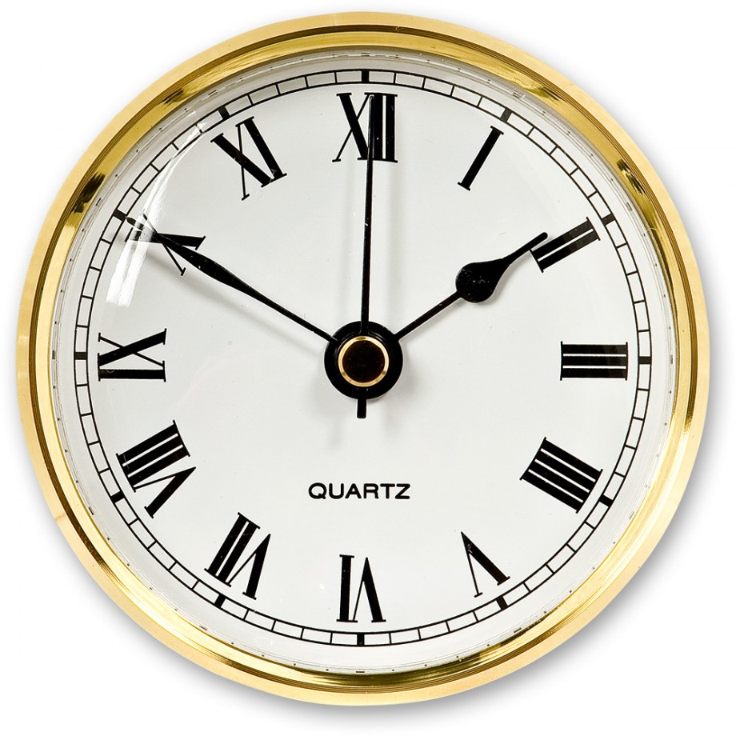
Time Complexity
Sorting algorithms are classified by time complexity – how long they take and how many switches they need to make to sort an array.
The time complexity of an algorithm is denoted by the Order of the algorithm – called big-O.
If an algorithm traverses an array one time, we say that it is of Order n or O(n), where “n” is the number of entries in the array.
Comparing Sorting Algorithms

Slide 24
Bubble Sort
One of the slowest and simplest sorting arrays is called the Bubble Sort.
The Bubble Sort works by repeatedly stepping through the array, and compares each pair of elements as it goes.
If the elements are out of order, they are switched and the next pair is examined.
This happens until the array is sorted.
Bubble Sort Algorithm

Slide 25
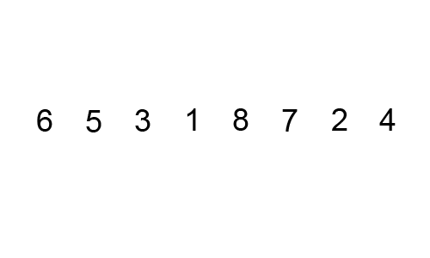
Bubble Sort
The Bubble Sort is of Order n² or O(n²).
This means that if the array has 500 elements in it, the algorithm must do approximately 250,000 switches until it is sorted. Ew.

Slide 26
Insertion Sort

Slide 27
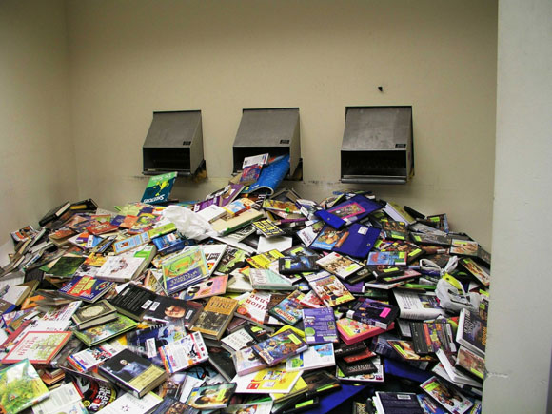
Insertion Sort
Another type of sorting algorithm is the Insertion Sort.
This algorithm starts by examining the first two elements in the array and sorting them.
Then, it examines the third element and places it in order with the first two.
The portion of the array before the examined element ends up being sorted before continuing to the next element.

Slide 28
Insertion Sort
Insertion Sort is also O(n²) but only if the array is in completely backwards order.
Usually, Insertion Sort makes fewer switches than Bubble Sort and takes less time.

Slide 29
Other Algorithms
There are many other algorithms used to sort arrays.
Some are very fast, some aren’t, and some only work on specific data sets.
Let’s have a look.
https://imgur.com/gallery/iwTNP

