Slide 1
Designing a Program with Functions

Slide 2
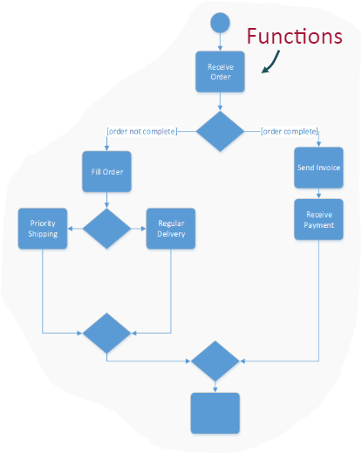
Designing with Functions
Functions allow us to use Decomposition in our programs.
Decomposition allows us to break down programs into smaller, more manageable units of code.
Each of these units will be performed by a function.

Slide 3
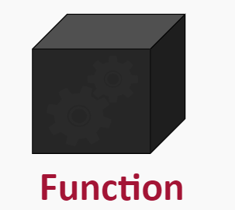
The Black Box
The idea of the function as a black box simply means that you don’t need to know what’s going on inside a function in order for you to be able to call that function.

Slide 4
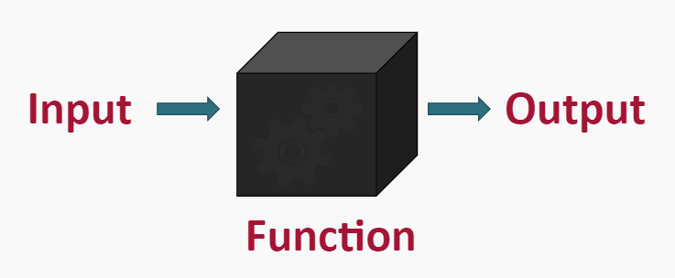
The Black Box
The idea of the function as a black box simply means that you don’t need to know what’s going on inside a function in order for you to be able to call that function.

Slide 5
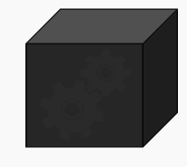
The Black Box
In order to use the function you need to know more than:
What is the name of the function?
What is its identifier?
What is the function supposed to do?
What information does the function need?
What arguments does it need given to it?
What information will the function give back?
What does it return?

Slide 6
The Black Box
Suppose I have written a function called multiplyNumbers():
What is the name of the function?
What is the function supposed to do?
What information does the function need?
What information will the function give back?

Slide 7
The Black Box
Suppose I have written a function called multiplyNumbers():
What is the name of the function? Answer: multiplyNumbers()
What is the function supposed to do? Answer: multiply two numbers
What information does the function need? Answer: two numbers
What information will the function give back? Answer: the result of the multiplication

Slide 8
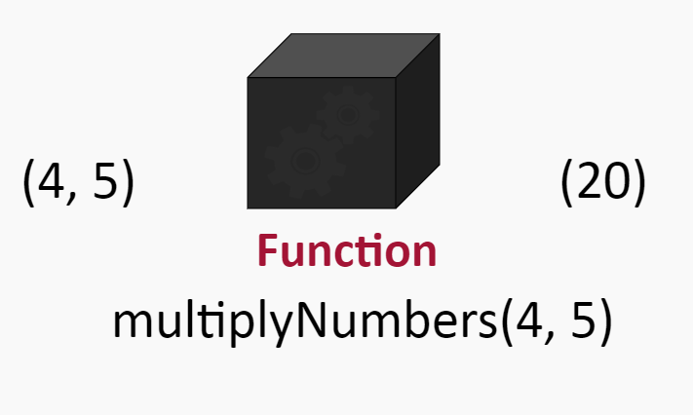
The Black Box Example

Slide 9
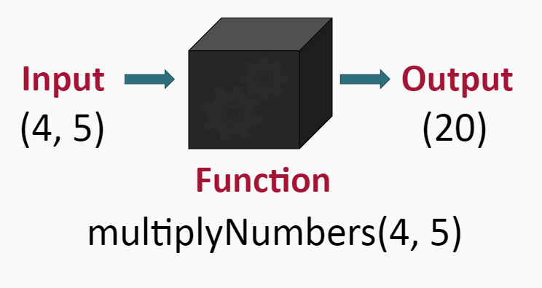
The Black Box Example

Slide 10
Rules of Black Boxes
Using a “black box” function should be straightforward, well-defined and easy to understand.
To use a “black box” function, you shouldn’t need to know anything about how it works; all you need to know is how to use it.

Slide 11
Summary
When designing with Functions follow these simple standards:
A function should be concise, self-contained, and only do one thing.
A function should not depend on any external variables to do its job.
A function should be easy to use without knowing how the function works in detail.

