Slide 1
Function Variable Scope

Slide 2
Variable Scope
The Scope of a variable is where it exists and can be used by your program.
Variables are Scoped to functions
This means that if they are created in a function, they can’t be used outside of that function.
If a variable is out of scope then it cannot be used by that part of the program.

Slide 3
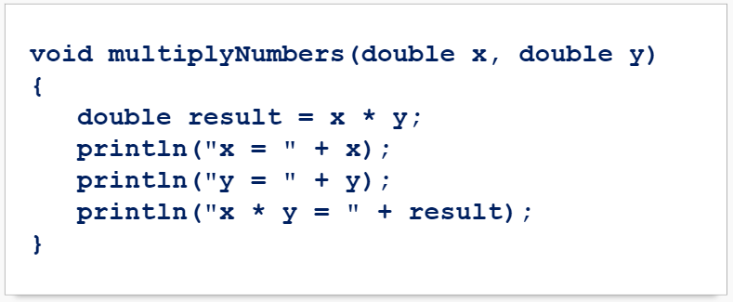
Variable Scope Example
Let’s create a function that multiplies two numbers and prints the result:

Slide 4
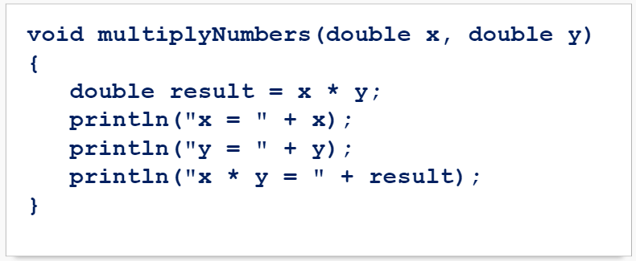
Variable Scope Example
Note that 3 new variables are being created here:

Slide 5
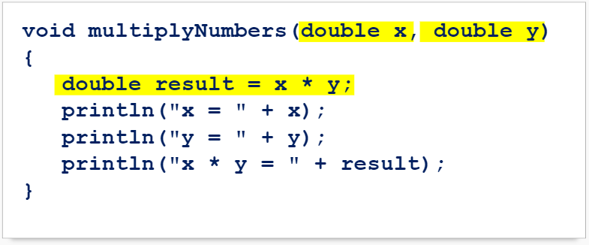
Variable Scope Example
Note that 3 new variables are being created here:

Slide 6
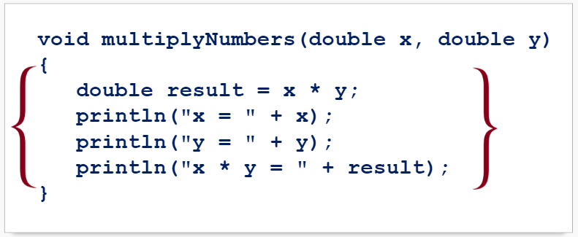
Variable Scope Example
These 3 new variables can only be used inside this function:

Slide 7
Variable Scope
Trying to use these variables anywhere else in your program will result in an error:

Slide 8
Summary
Variables created inside of a function can not be used outside of that function.
This is called a variable’s Scope.
If you try to use a variable out of scope, it will result in a variable not found error.

