Slide 1
Strings

Slide 2
Strings

Slide 3
String Basics
Unlike most other programming languages, Processing does not have primitive data type to hold strings.
While the ‘char’ data type does exist, it can only contain a single character.
If you need to work with strings, you need to use the String Class.

Slide 4
String Basics
Strings are always enclosed in “double quotes”
568765 and “568765”
are not the same thing

Slide 5
String Basics

Slide 6
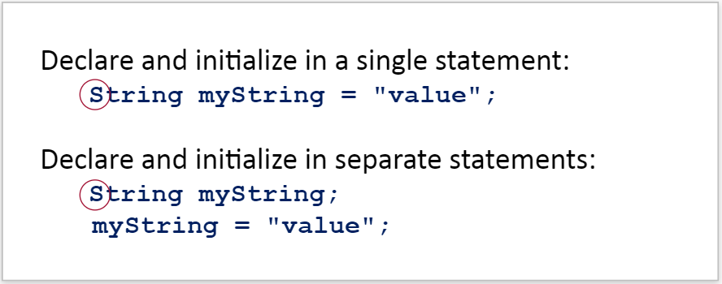
Creating Strings
Strings are created in a similar manner to all other data types and can be created in two ways:

Slide 7
Creating Strings Practice
Fill in the blanks in the code snippet below to declare a String variable called lastName with the value Jones

Slide 8
Creating Strings Practice
Fill in the blanks in the code snippet below to declare a String variable called name with the value Mike

Slide 9
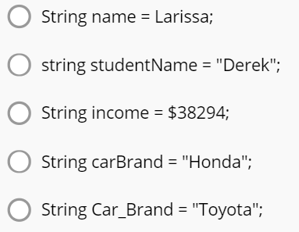
Creating Strings Practice
Which of the following follows the rules and standards of declaring a String?

Slide 10
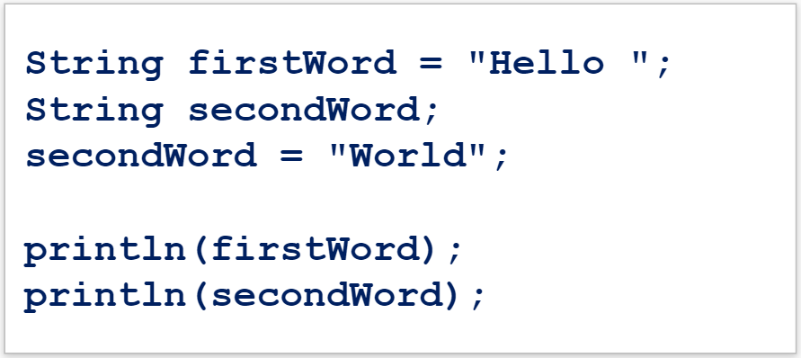
Hands On – Creating Strings
In Processing, create a new sketch and enter this code:

Slide 11
Hands On – Creating Strings

Slide 12
Hands On – Creating Strings

Slide 13
Hands On – Creating Strings

Slide 14
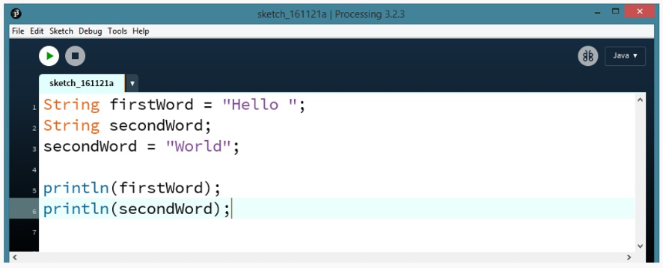
Hands On – Creating Strings
What do you think this code will output when run?

Slide 15
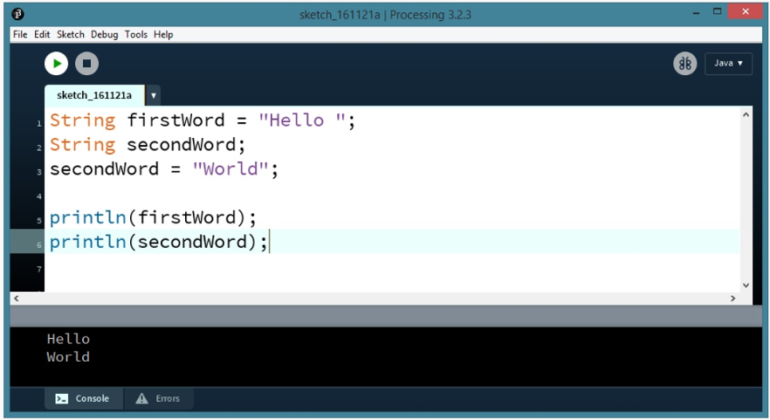
Hands On – Creating Strings
What do you think this code will output when run?

Slide 16
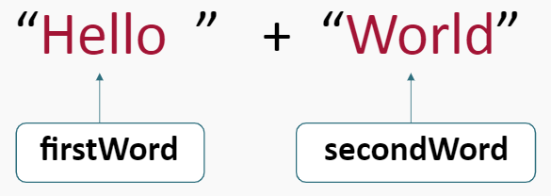
Concatenation
Now we want to put the strings together

Slide 17
Strings - Concatenation
The problem is that println() only prints one thing at a time.
We can accomplish this by Concatenating Strings together.
Concatenation means to create one new String out of two or more existing ones.
Strings are concatenated together using the plus ‘+’ symbol.

Slide 18
Strings - Concatenation
Integer Addition:
Concatenation:

Slide 19
Strings - Concatenation
Integer Addition:
Concatenation Output:

Slide 20
Hands On - Concatenation
Change your code as follows: (add the code in red)

Slide 21
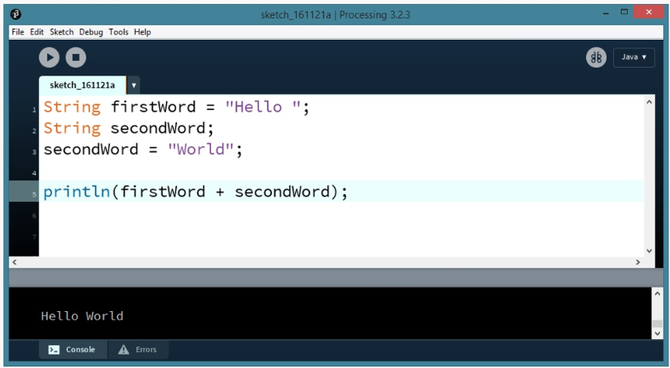
Hands On - Concatenation

Slide 22
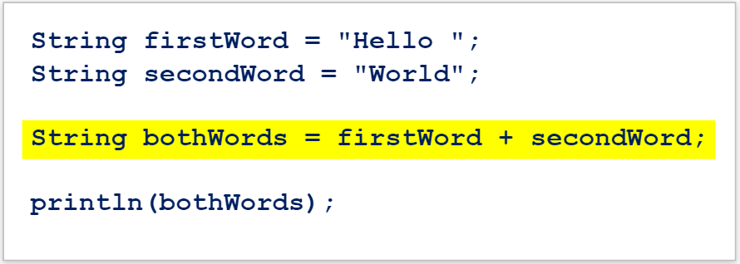
Hands On - Concatenation
You can accomplish the same thing by concatenating to a String variable and printing that String variable:

Slide 23
String Concatenation
Strings can be concatenated with other data types.
If a String is concatenated with a number, the integer and String will be stuck together and no math will be performed.
This code will output 23, try it yourself in Processing!

Slide 24
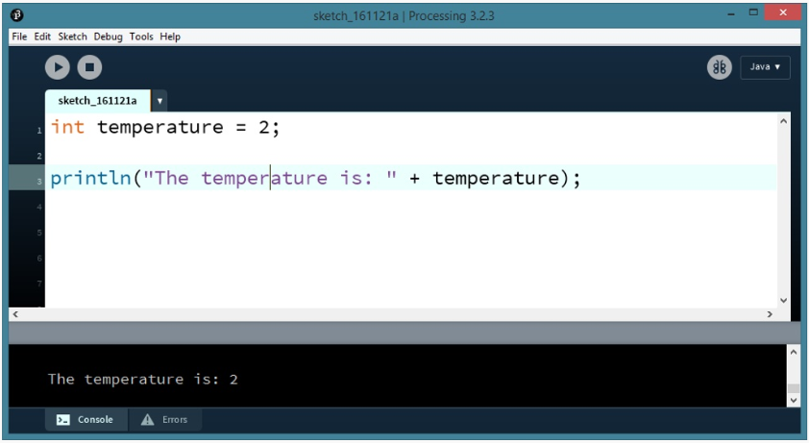
String Concatenation Example
Here is an example of a String being concatenated with an Integer:

Slide 25
String Basics Practice
Fill in the blanks in the code below so that it outputs:

Slide 26
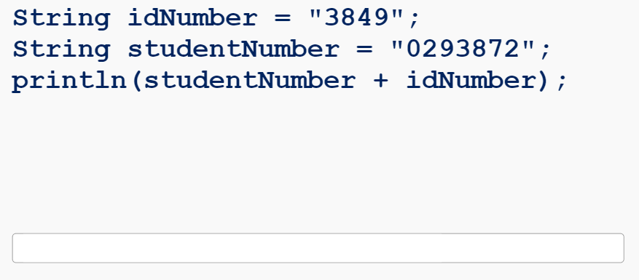
String Basics Practice
Type the output of the following code:

Slide 27
String Basics Practice
Fill in the blanks in the code below so that it outputs:

Slide 28
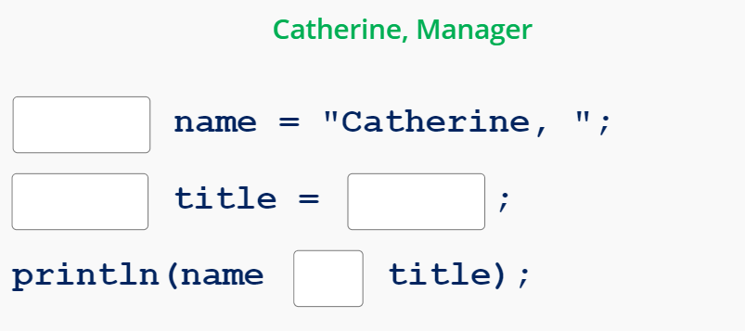
String Basics Practice
Fill in the blanks in the code below so that it outputs:

Slide 29
Summary
A String is a collection of characters.
A String is declared by using:
Strings are always initialized with double quotes

Slide 30
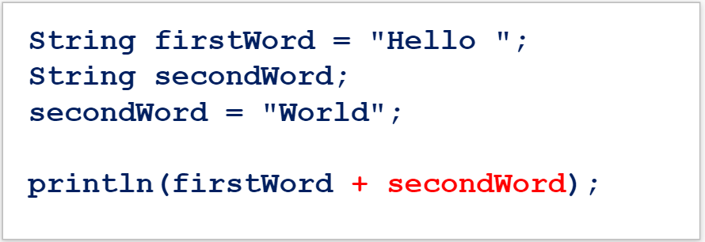
Summary
Concatenation means to create one new string out of two or more existing ones.
Strings can be Concatenated using the plus sign (+)

