Slide 1
Interactive Sketches

Slide 2
Static vs Interactive
A program written as a list of statements (like the previous examples) is called a Static sketch.
Static programs are most commonly used for extremely simple examples, or for scripts that run in a linear fashion and then exit.
Interactive programs are drawn as a series of frames, which you can create by adding functions titled setup() and draw(). These are built in functions that are called automatically.

Slide 3
Static Sketches
Static sketches run a list of statements in a linear order The statements run and then program exits.
For example, the following program will draw an orange ellipse at position (50,50) and then exit.

Slide 4
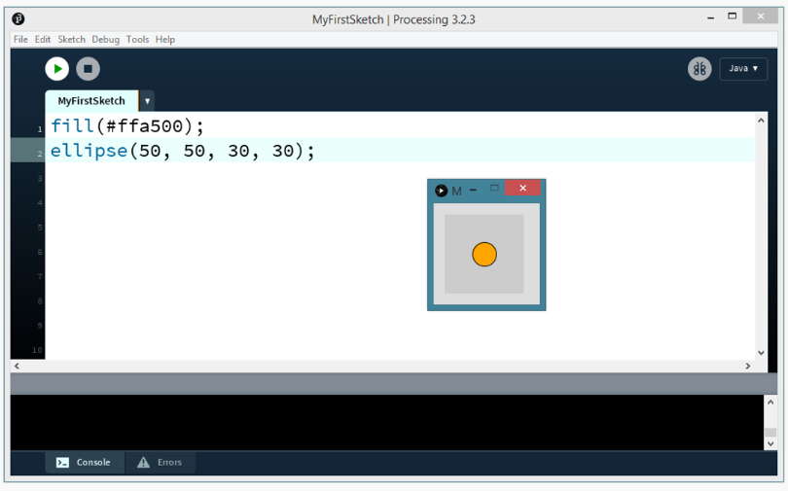
Static Sketches

Slide 5
Interactive Sketches
Interactive Sketches contain two special functions that allow them to run constantly and so allow for interactivity and animation
The setup() function allows the programmer to setup the display window for the interactive program.
The draw function runs continuously to allow for event listening, interactivity and animation.

Slide 6
Setup()
The setup() function sets up an interactive sketch. Code inside the setup() block runs once.
Setup() can be used for any initialization such as, setting the screen size, setting the background color, and setting the stroke or fill colors.
The size() function must be the first line in the setup() function.

Slide 7
Setup()
The setup function does not return any data, therefore it’s return type is void.
You can create a setup() function with the following syntax:

Slide 8
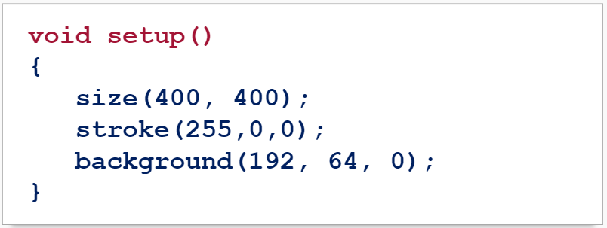
Setup()
For example, this setup() function sets the size of the display window, sets the stroke color to red and sets the background color to orange:

Slide 9
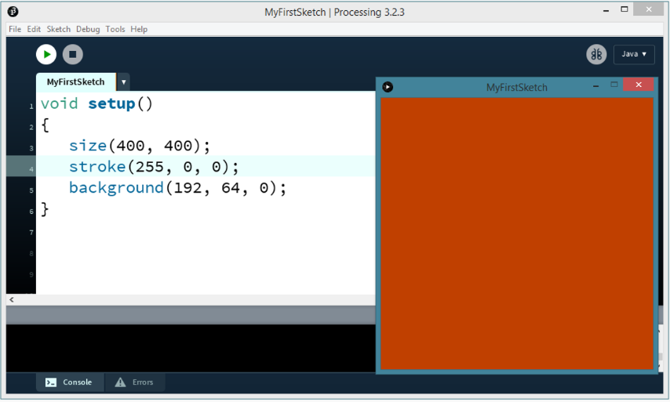
Setup()

Slide 10
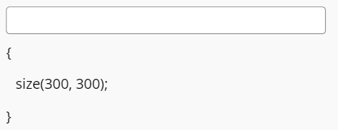
Setup Practice
Fill in the blanks in the code snippet below to create a setup function that sets the display window to 300px by 300px.

Slide 11
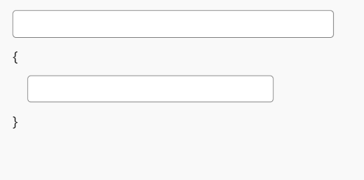
Setup Practice
Fill in the blanks in the code snippet below to create a setup function that sets the background color to black (0).

Slide 12
Draw()
The draw() function runs 60 times (or frames) per second continuously until stopped.
The draw function is used to handle animation of any kind. The draw() function is defined using the syntax:

Slide 13
Draw() Example
After your setup() function, add this draw() function.
This draw() function creates circles that are 30px by 30px at your current mouse position (mouseX, mouseY):

Slide 14
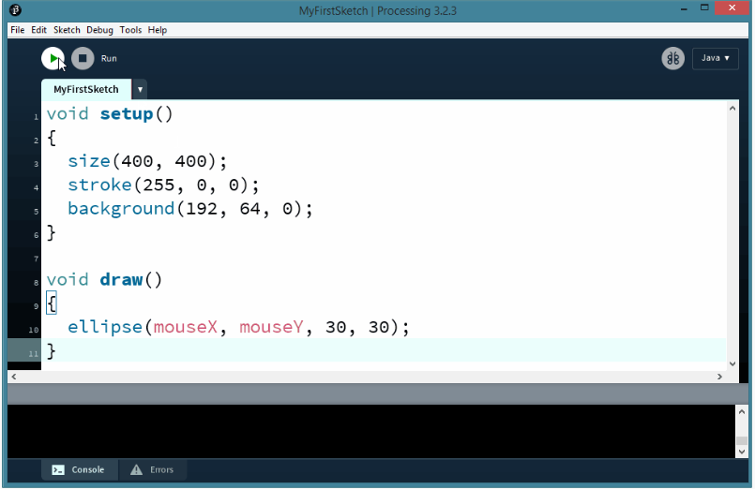
Draw() Example

Slide 15
Summary
A program written as a list of statements (like the previous examples) is called a Static Sketch. Static Sketches cannot run animation or interactivity.
Interactive Sketches can run animation and interactivity and require two functions: setup() and draw().
The setup() function is automatically called once at the start of the program. The draw() function is automatically called 60 times/second until stopped.

Slide 16
Summary
Setup:
Draw:

