Slide 1
Comments in Processing

Slide 2
Comments
Comments are a standard thing to do in a program.
They are ignored by Processing; rather they are there for programmers to easily understand what the code is attempting to do.
While you might understand clearly what your code is doing today, in 6 months from now it might not be so obvious.
Explaining the code in plain English sentences makes this understanding (for yourself and others) much easier.

Slide 3
Comments
There are two primary types of comments used in a Processing sketch:
Single Line comments //
Short, single line comments
Multi-Line Comments /* */
Complex comment requiring several lines

Slide 4
Single Line Comments
Single line comments start with the double forward slash (//).
Any text after the slashes are ignored by Processing.
This type of commenting is typically found on its own line above the statement it’s commenting on.

Slide 5
Multi-Line Comments
Multi-Line Comments (also called Block Comments) are used to comment one or more lines of code.
The comment block starts with /* and ends with */.
Multi-Line comments are used when the explanation span more than a single line.

Slide 6
Multi-Line Comments
Source documents often begin with multi-line comments explaining the purpose and functionality of the code.
These comments may also show who created the code, when it was created, when it was modified and by whom.

Slide 7
Comments for Debugging
You can use comments to help test your code.
For example, the code below will output “Hello World”:
This code uses comments to only output “World”:

Slide 8
Comments for Debugging
Use comments to temporarily prevent a line of code from running.
This is helpful for debugging as you can simplify your program to help you find the issue.

Slide 9
Comments Practice
Fill in the blanks in the code snippet below to create a single line comment.

Slide 10
Comments Practice
Fill in the blanks in the code snippet below so the code outputs “Hello”.

Slide 11
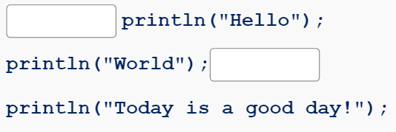
Comments Practice
Fill in the blanks in the code snippet below so the code outputs “Today is a good day!”

Slide 12
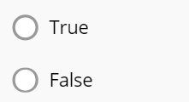
Comments Practice
Choose whether the statement is true or false:
“Comments are required for the program to run.”

Slide 13
Summary
Comments are a standard thing to do in a program.
They are ignored by Processing; rather they are there for programmers to easily understand what the code is attempting to do.
Single line Comments are used to comment a single line and are started with two forward slashes (//).
Multi-line Comments are used to comment multiple lines and use the syntax /* and */.

