Slide 1
Calculating and Returning Values

Slide 2
Functions Return Data
We can use functions to solve a problem and return the answer.
We can then store that data into a variable that we can use later.
Example: Ask.forString

Slide 3
Return Types
To create a function that returns some data, we need to specify what type of data will be returned. We do this with the Return Type.
Up until now, we’ve only worked with a void function that doesn’t return any data.

Slide 4
Return Types
To start, let’s create a function that multiplies two numbers together and returns a double value.
This function has two parameters, a double x and a double y:

Slide 5
Returning Data
We’ve now created a function that has a return type of double and receives an x and y argument.
We now have to tell our function what data to return:

Slide 6
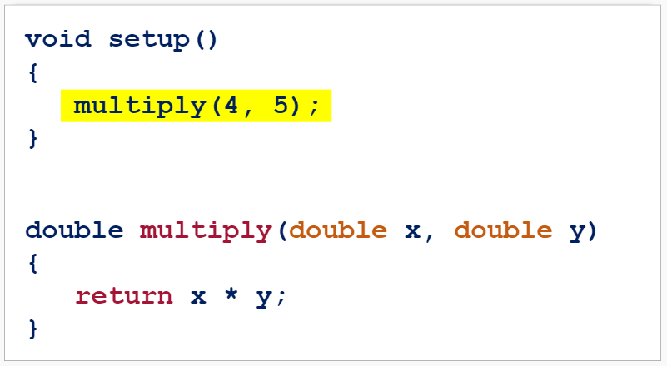
Calling a Function
If we call the function now, nothing will happen:

Slide 7
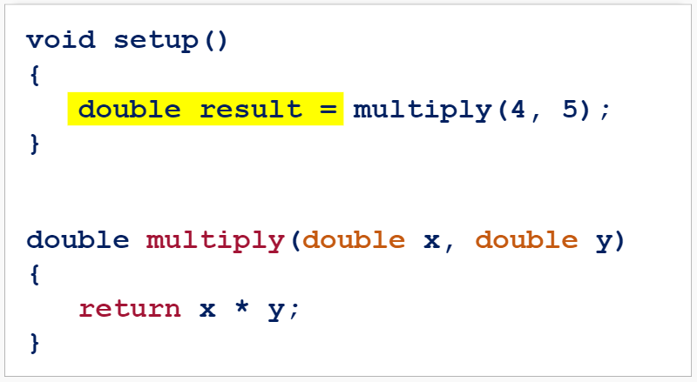
Calling a Function
We must first store the data to a variable:

Slide 8
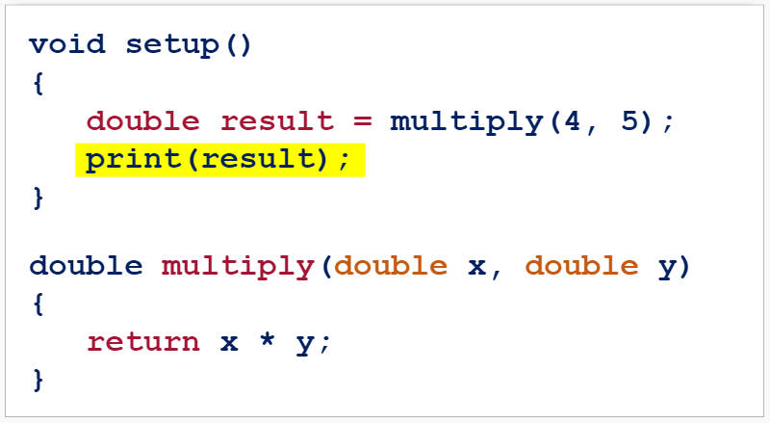
Calling a Function
And then print the result to the console:

Slide 9
Running the Program

Slide 10
Try It Yourself
Create a function that converts feet to inches (there are 12 inches in a foot).
The function should have a double parameter feet and return the number of inches.
Print the number of inches to the console:

Slide 11
Try It Yourself Solution

Slide 12
Summary
We can use functions to return some data.
We can then store that data into a variable that we can use later.
When we create a function, we must define the type of data it will return and return the data:

Slide 13
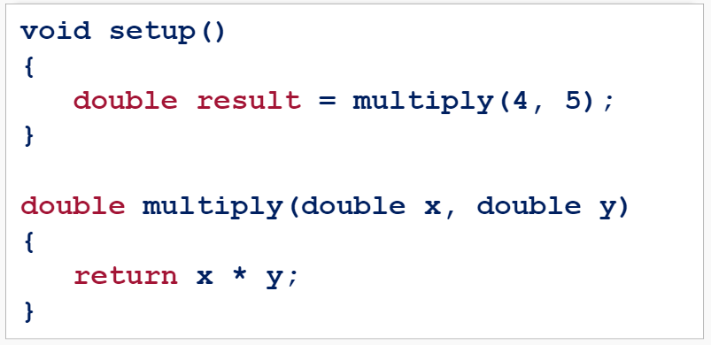
Summary
When calling a function with a return type, we must store the data it returns in a variable:

