Slide 1
Numeric Data Types

Slide 2
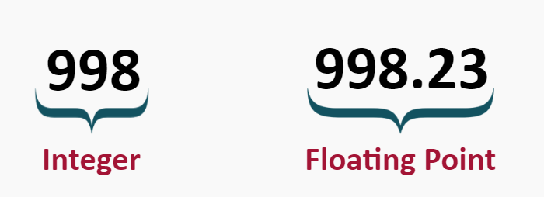
Numeric Data Types
Numeric Data Types can contain numbers of different types and sizes.
Different data types are needed for Integers and Floating Point Numbers.

Slide 3
Integer Data Types
Integer data types can contain a number that does not have any decimals
Some examples of integers include:
1, 3, 4, 19, 2838292, -10232782
There are different types of integers depending on the size of the data:

Slide 4
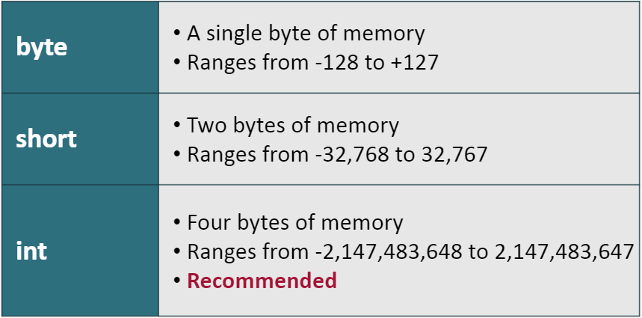
Integer Data Types

Slide 5
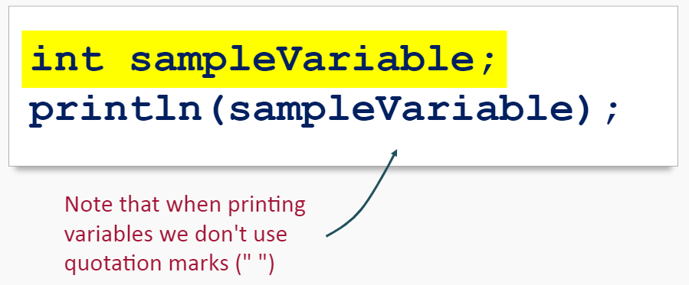
Try It Yourself
Create a new sketch and add the following code:
This code is declaring a variable and then printing it to the console.

Slide 6
Try It Yourself
You should get the following error:

Slide 7
Try It Yourself
Why did you get this error?
Let’s add one more thing…

Slide 8
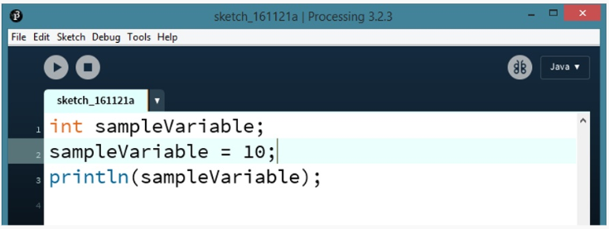
Try It Yourself
Add the line:

Slide 9
Initializing a Variable
This code:
Initializes the variable
sampleVariable to the value 10
Now that the variable has a value (is initialized), the sketch should run with no errors

Slide 10
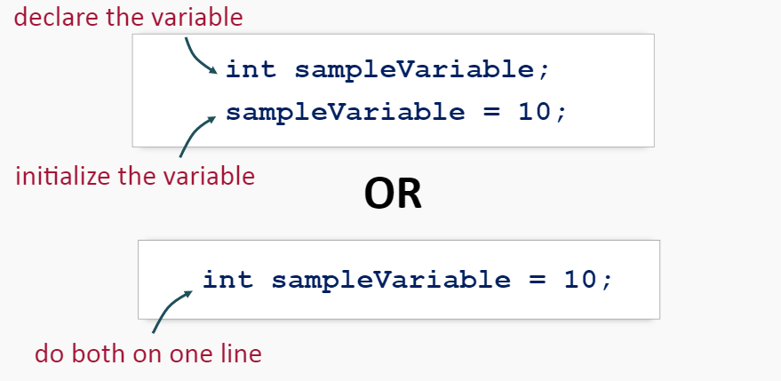
Initializing a Variable
There are two ways to give a variable a value:
OR
Try them both yourself!

Slide 11
Initializing a Variable
Now run your program!

Slide 12
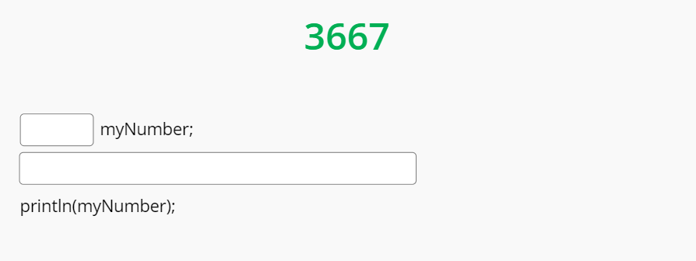
Integer Data Types Practice
Fill in the blank fields in the code snippet below to produce the output:

Slide 13
Floating Point Data Types
Floating Point data types can contain a number that does have decimals.
Some examples of floats include:
0.0003, 12.3, 99.0, 998.8293
There are different types of floats depending on the size of the data:

Slide 14
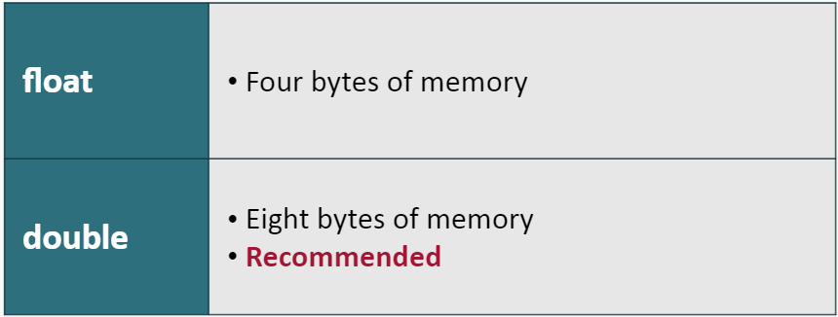
Floating Point Data Types

Slide 15
Initializing a Double
This code:
Declares and Initializes the double variable identifier to the value 99.23

Slide 16
Summary
Integers are whole numbers with no decimals.
Int is the most common and recommended integer data type.
Variables must be initialized (given data) before they can be used and can be initialized with the following syntax:

Slide 17
Summary
Floating Point Numbers have numbers after the decimal point.
Use the double data type when working with floating point numbers.

