Slide 1
Generating Output

Slide 2
Generating Output
The purpose of any computer program is to generate output.
A program’s output could be as simple as displaying something to the user’s screen.
Output could also be generated in a file, printed on paper using a printer, emailed to a friend, etc.
In this course, a majority of the output will be presented on the user’s screen in the terminal window.

Slide 3
print() & println()
and

Slide 4
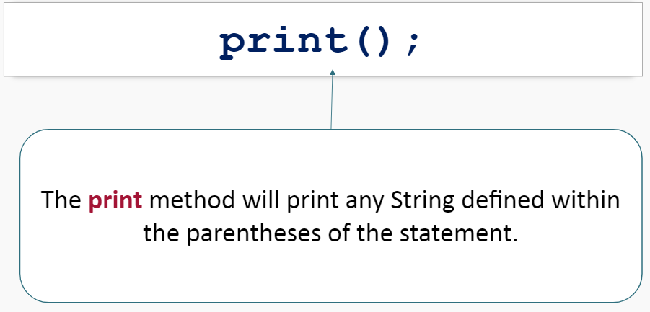
Print() & println()

Slide 5
print()
The print method will print any String defined within the parentheses of the statement.
Will output:

Slide 6
print()
After generating the output, the print method will keep the cursor at the end of the current line. Which means, any additional output would occur on the same line:
Will output:

Slide 7
print()
This is a desired method of output for prompting users for data.
For example:
Will output:

Slide 8
println()
The println (print line) method works exactly like the print method with one exception.
The println method will put a new line character at the end of the output.
Which means, any additional output will start on the next line.

Slide 9
println()
For example:
Will output:

Slide 10
Summary
The print() and println() methods both print output to the screen.
The print() method will keep the cursor at the end of the current line. This makes the print() method ideal for prompting for user input.
The println() method will put additional output on a new line.

