Slide 1
Function Parameters and Arguments

Slide 2
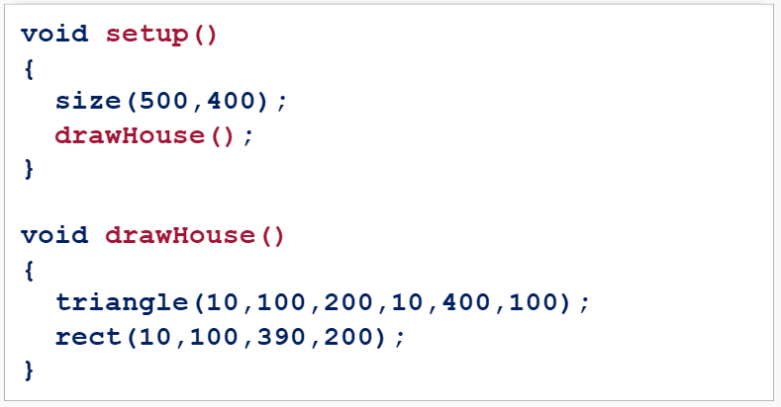
Creating a Function
You’ve created a function that builds a house and you called it from the setup() function:

Slide 3
Function Parameters
What if we want to change colors of our house each time we call the function?
The drawHouse() function needs to be able to get those color details in order to use them.
Functions get details through Parameters.

Slide 4
Function Parameters
Parameters are setup when you create a function:

Slide 5
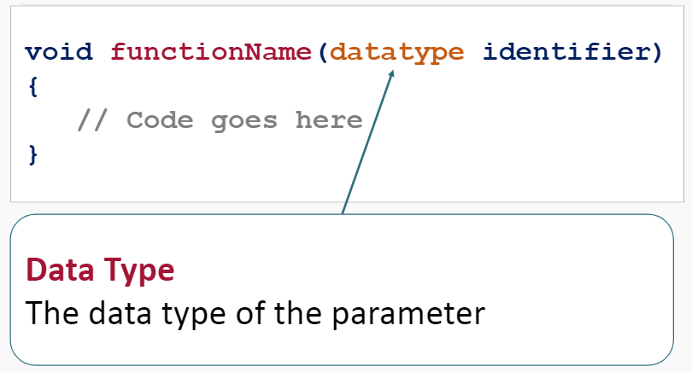
Function Parameters
Parameters are setup when you create a function:

Slide 6
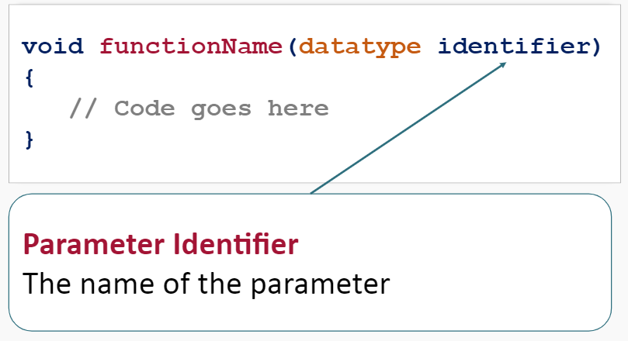
Function Parameters
Parameters are setup when you create a function:

Slide 7
Function Parameters
Your function can now use the parameters:

Slide 8
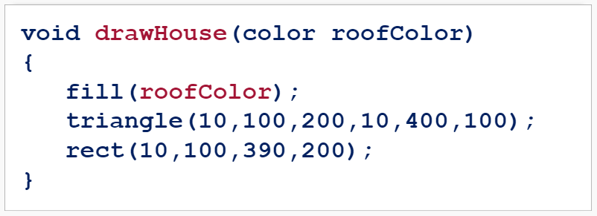
Function Parameters
Let’s give our drawHouse() function a roof color parameter of type color:

Slide 9
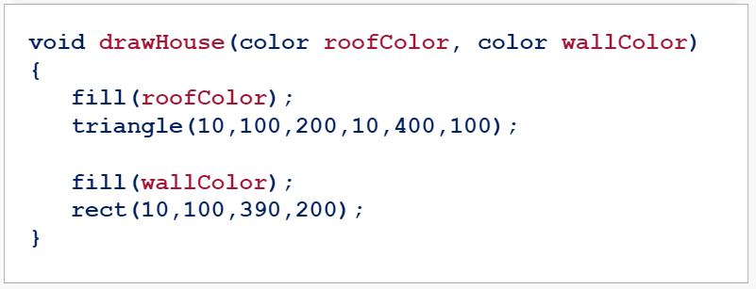
Function Parameters
Let’s give our drawHouse() function a roof and wall color parameters of type color:

Slide 10
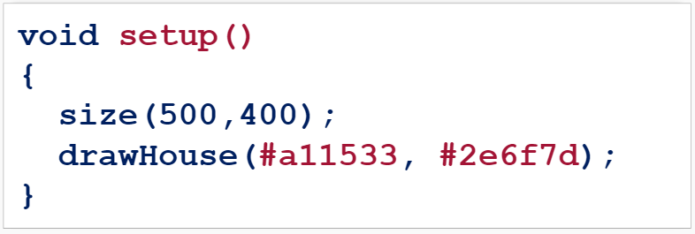
Function Arguments
Now we can send data to our function when we call the function in the setup() function:

Slide 11
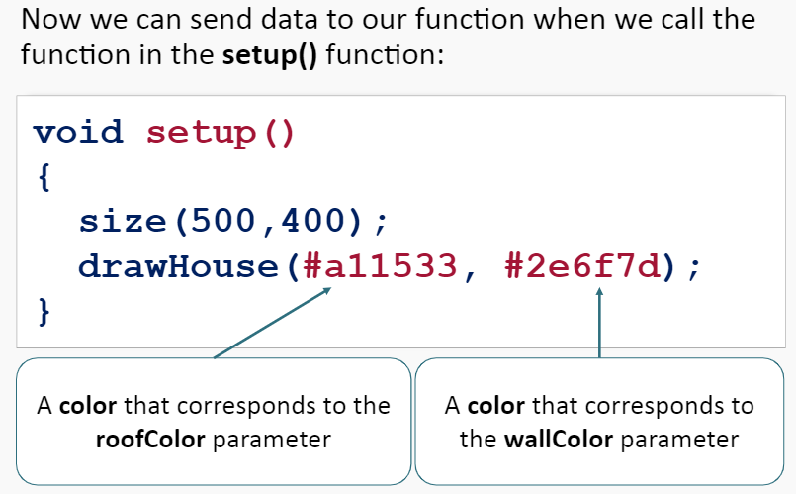
Function Arguments
Now we can send data to our function when we call the function in the setup() function:

Slide 12
Function Arguments

Slide 13
Try It Yourself
Create a function that draws a target at given coordinates.
This function has two parameters:
An integer parameter called xPosition
An integer parameter called yPosition
Call this function in a draw() function with mouseX and mouseY arguments.

Slide 14
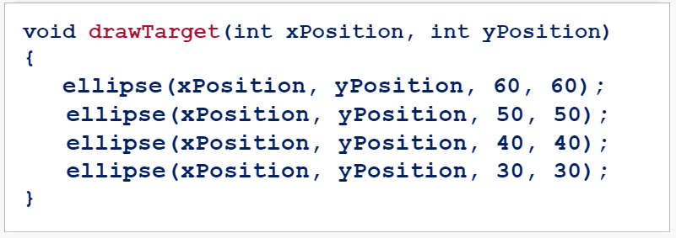
Create a Function
Create a function called drawTarget() that creates a circle with integer xPosition and yPosition parameters:

Slide 15
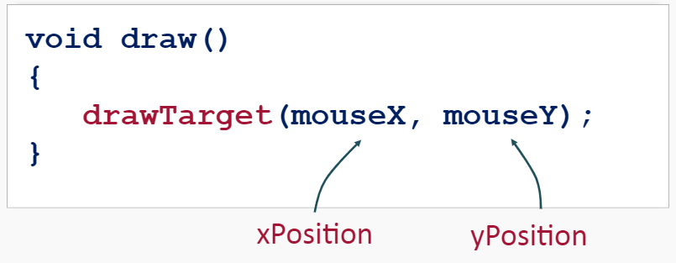
Call the Function
Call the drawTarget() function with appropriate arguments within a draw() function.

Slide 16
Run the Program

Slide 17
Summary
Functions can use details sent to them by way of Arguments.
In order to accept Arguments the function must be setup with appropriate Parameters.

Slide 18
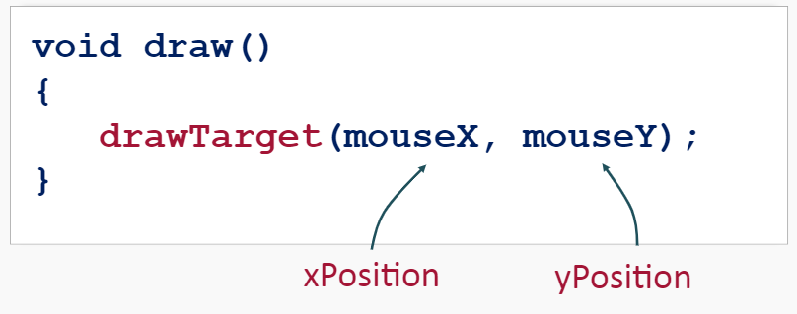
Summary
Function Arguments are passed to a function when it is called and correspond to the function’s Parameters.

