Slide 1
While Loops

Slide 2
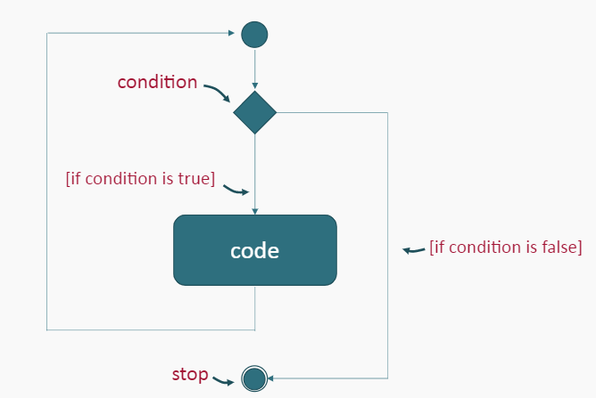
While Loops
The while loop is a pre-test loop.

Slide 3
While Loops
In a pre-test loop, conditions of the loop are tested before the code is run.
In a While Loop, a statement or statements are repeated while a condition is true.
The loop stops when the condition evaluates to false.

Slide 4
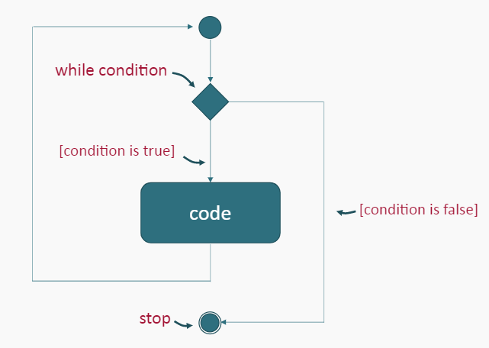
While Loop Activity Diagram

Slide 5
While Loops Syntax
A while loop has the syntax:

Slide 6
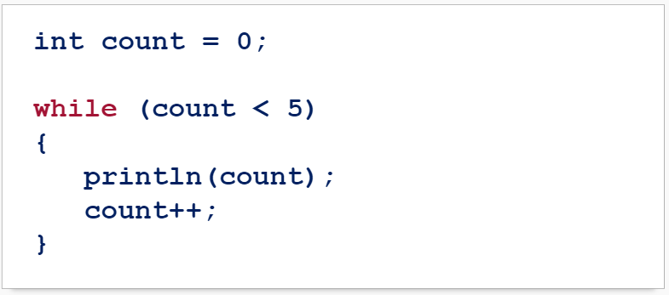
While Loop Example
What is the output of this code?

Slide 7
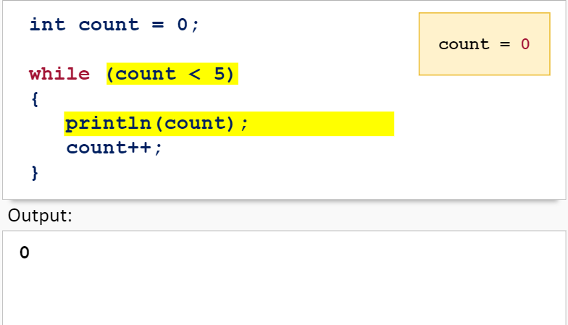
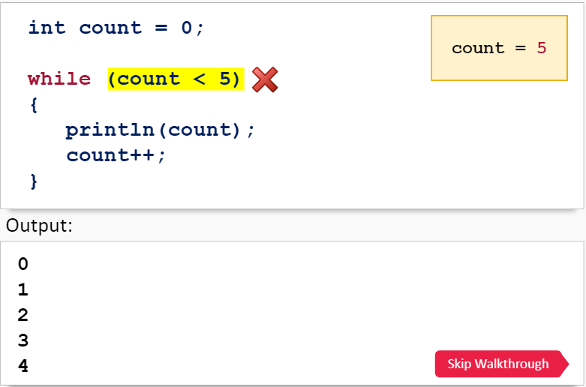
While Loop Walkthrough

Slide 8
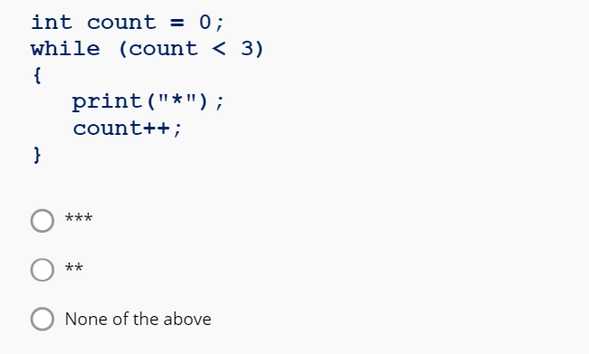
While Loops Practice
What is the output of the following code snippet?

Slide 9
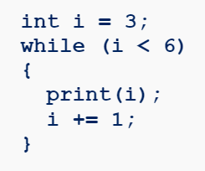
While Loops Practice
What is the output of the following code snippet?

Slide 10
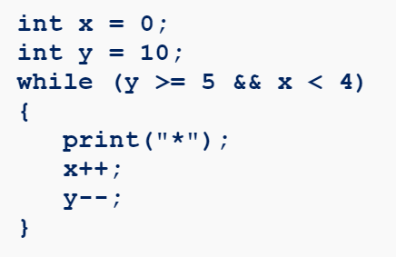
While Loops Practice
What is the output of the following code snippet?

Slide 11
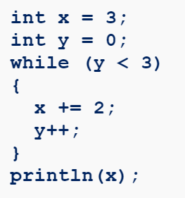
While Loops Practice
What is the output of the following code snippet?

Slide 12
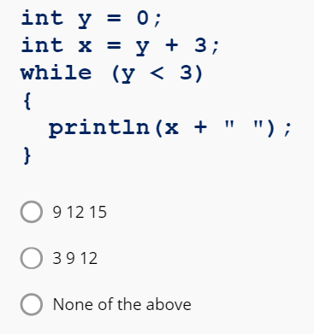
While Loops Practice
What is the output of the following code snippet?

Slide 13
Try it Yourself
Create a sketch that displays stars for any given rating.
This sketch must:
Ask the user for a rating between 1 and 5.
(Remember to parse the input to an integer)
Use a while loop so that for each number of the rating, print out a star symbol or image.
For example: if the user inputs a rating of 2, your program should output: **

Slide 14
Try it Yourself
Create a sketch that uses loops, if statements and images to create a tug of war game that looks similar to this:

Slide 15
Summary
A while loop is a type of pre-test loop which means that the condition is tested before the code inside the loop is run.
A while loop has the syntax:

