Slide 1
Using a Custom Function

Slide 2
Static and Interactive Sketches
Custom functions can only be run in interactive sketches.
Remember that interactive sketches must contain a setup() and/or a draw() function.
In order to run a custom function, you must create at least one setup() or draw() function.

Slide 3
Creating a Function
First we must set our stage by creating a setup() function:
Then we create our drawTarget custom function:

Slide 4
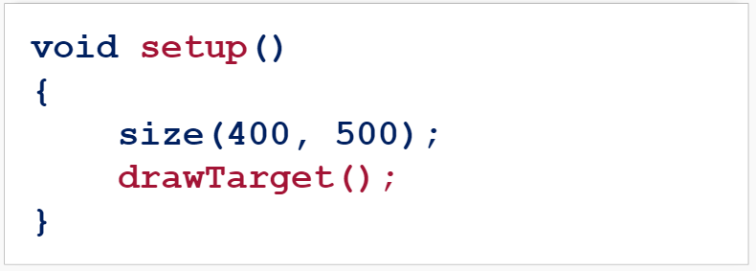
Calling a Function
Now we call our drawTarget() function inside our setup() function:

Slide 5
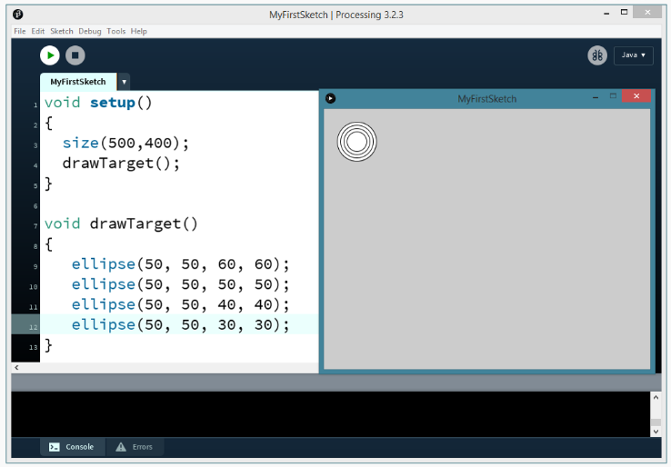
Calling a Function

Slide 6
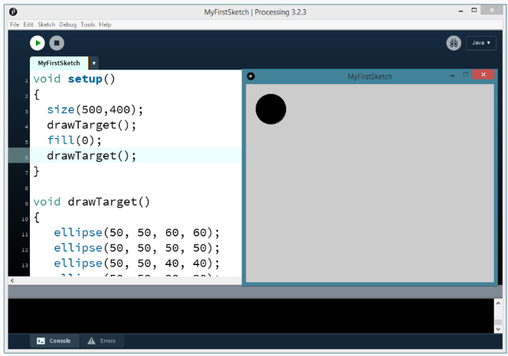
Calling a Function
You can call custom functions as many times as you want:

Slide 7
Try It Yourself
Create a function that draws a house.
Call the function within a setup() function.

Slide 8
Summary
Custom functions can only be called in interactive sketches.
Custom functions must be called in either a setup() or draw() function.
Custom functions are called the same way as built-in processing functions.

