Slide 1
Logical Operators

Slide 2
Logical Operators
Logical Operators turn Boolean expressions into operands to form a larger Boolean expression that evaluates to true or false.
The Logical Operators include:

Slide 3
The AND Operator (&&)
If the operands on both sides of the AND Operator (&&) are true then the entire expression is true.
If either of the operands evaluates to false, or they both do, the expression is false.
Syntax:

Slide 4
The AND Operator Syntax

Slide 5
The AND Operator

Slide 6
The AND Operator

Slide 7
AND Operator Evaluations

Slide 8
The AND Operator Example

Slide 9
The AND Operator Example

Slide 10
Logical Operators Warning
A Boolean expression cannot be a series of inequalities
Instead, check the variable pressure to the other variables independently

Slide 11
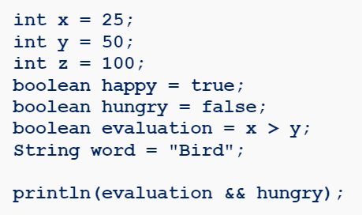
The AND Operator Practice
What is the output of the following code snippet:

Slide 12
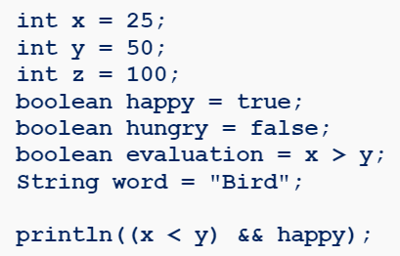
The AND Operator Practice
What is the output of the following code snippet:

Slide 13
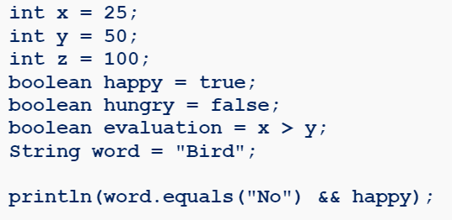
The AND Operator Practice
What is the output of the following code snippet:

Slide 14
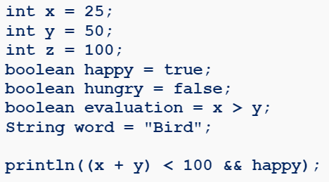
The AND Operator Practice
What is the output of the following code snippet:

Slide 15
The OR Operator (||)
If the operands on either side of The OR Operator (||) are true then the entire expression is true.
If both of the operands evaluate to false, the expression is false.
Syntax:

Slide 16
The OR Operator

Slide 17
The OR Operator

Slide 18
The OR Operator

Slide 19
The OR Operator

Slide 20
The OR Operator

Slide 21
OR Operator Evaluations

Slide 22
The OR Operator Example

Slide 23
The OR Operator Example

Slide 24
The OR Operator Example
Create a program that will let the user know if they should bring an umbrella outside:
If the forecast says rain, then you should bring an umbrella
If it is raining outside, you should bring an umbrella
If the forecast does not say rain and it is not raining, you don’t need to bring an umbrella

Slide 25
The OR Operator Example

Slide 26
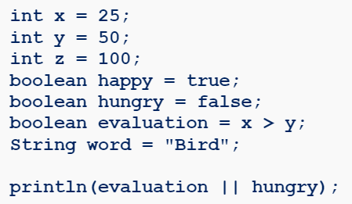
The OR Operator Practice
What is the output of the following code snippet:

Slide 27
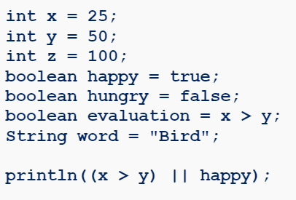
The OR Operator Practice
What is the output of the following code snippet:

Slide 28
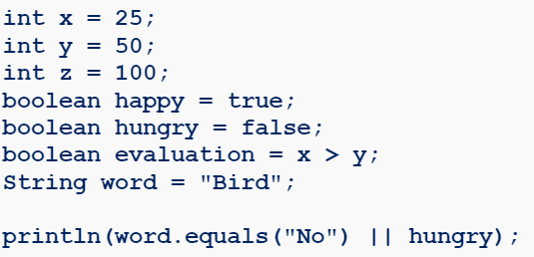
The OR Operator Practice
What is the output of the following code snippet:

Slide 29
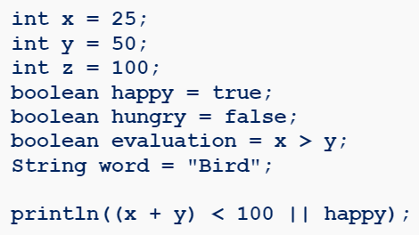
The OR Operator Practice
What is the output of the following code snippet:

Slide 30
The NOT Operator
The NOT Operator is represented by an exclamation mark (!).
The ! Operator changes Boolean value or expression to its opposite value.
Syntax:

Slide 31
The NOT Operator

Slide 32
The NOT Operator

Slide 33
The NOT Operator Example

Slide 34
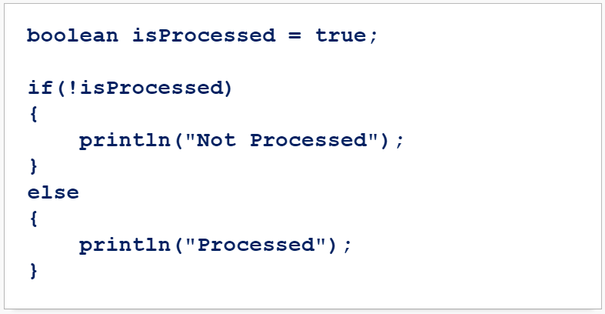
The NOT Operator Example
Consider this example, what is the output?

Slide 35
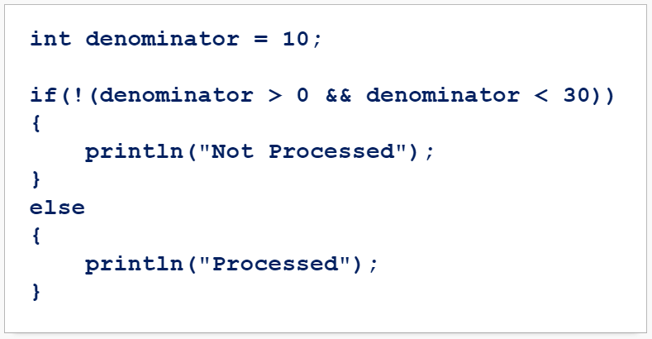
The NOT Operator Example
Consider this example, what is the output?

Slide 36
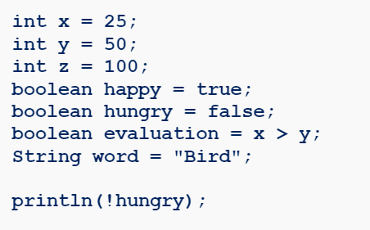
The NOT Operator Practice
What is the output of the following code snippet:

Slide 37
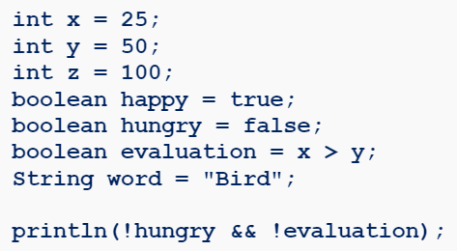
The NOT Operator Practice
What is the output of the following code snippet:

Slide 38
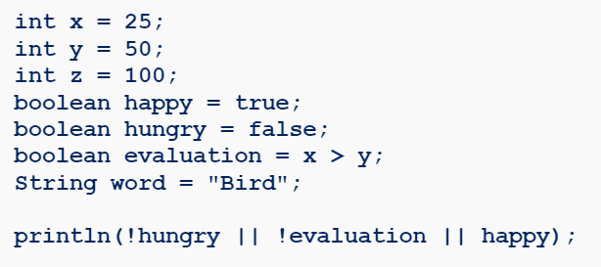
The NOT Operator Practice
What is the output of the following code snippet:

Slide 39
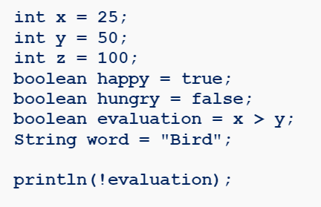
The NOT Operator Practice
What is the output of the following code snippet:

Slide 40
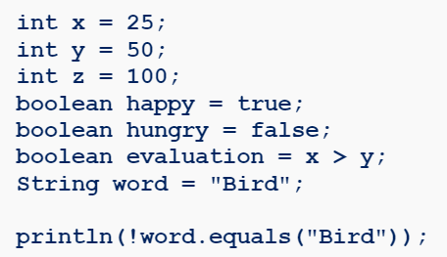
The NOT Operator Practice
What is the output of the following code snippet:

Slide 41
Summary
Logical Operators are: AND (&&), OR(||), NOT (!)
The syntax for logical operators is:
If the operands on both sides of the AND Operator (&&) are true then the entire expression is true.
If the operands on either side of the OR Operator (||) are true, then the entire expression is true.
The NOT (!) operator changes a Boolean value or expression to its opposite value.

