Slide 1
Variables

Slide 2
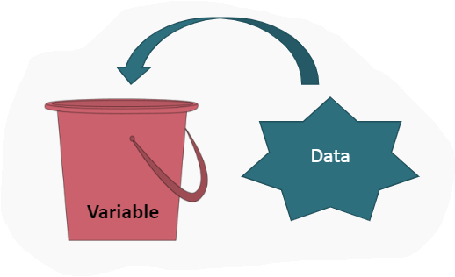
Variables
In order for a Processing Program to be useful, we need to be able to store information (data) as the program runs and change it as necessary.
We use variables in our program to accomplish the storage of data.

Slide 3
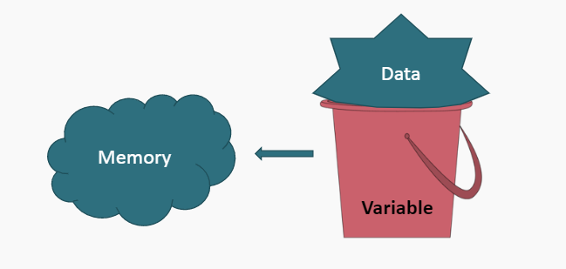
Variables
When a Processing program is executed, a variable declaration sets aside some memory to hold values we want to work with.

Slide 4
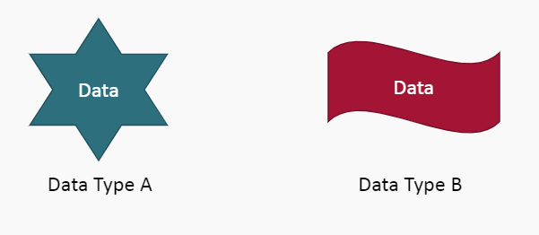
Variables Rules
You must declare a variable before you can use it.
You must identify what type of information the variable can contain. This is called a Data Type.

Slide 5
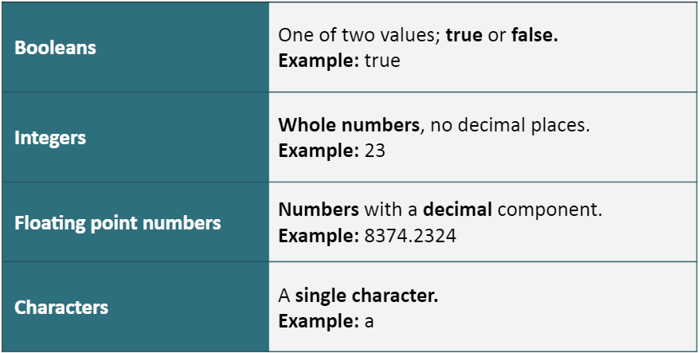
Primitive Data Types
The basic data types that Processing makes use of are referred to as Primitive Data Types:

Slide 6
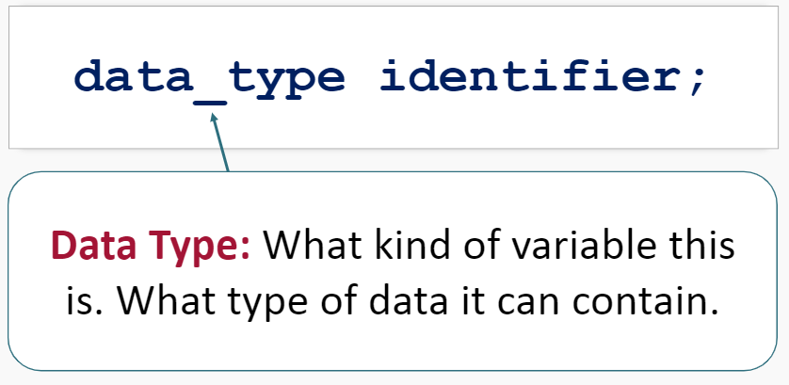
Declaring Variables
All variables are declared using the following syntax:

Slide 7
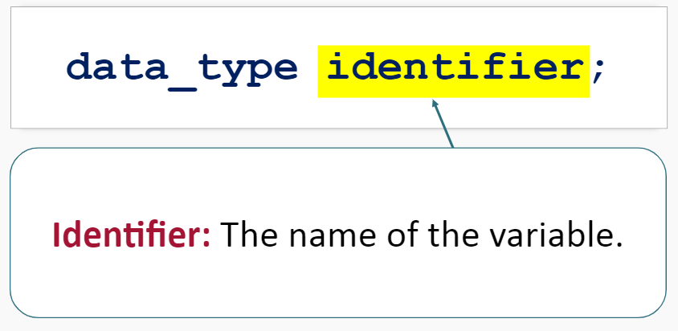
Declaring Variables
All variables are declared using the following syntax:

Slide 8
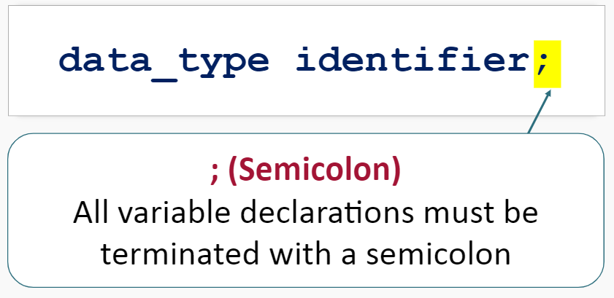
Declaring Variables
All variables are declared using the following syntax:

Slide 9
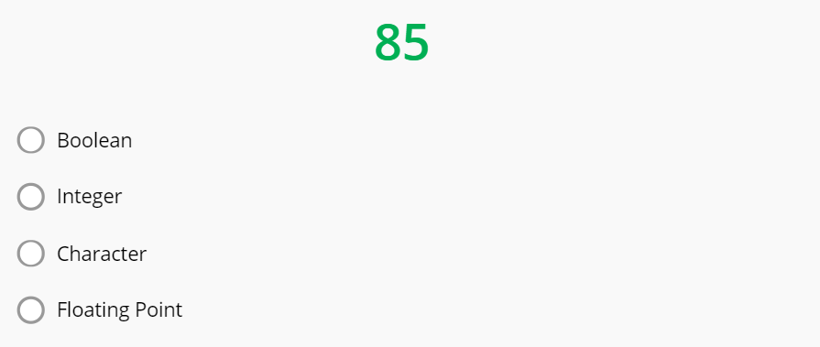
Primitive Data Types Practice
Which primitive data type should you use for the following data:

Slide 10
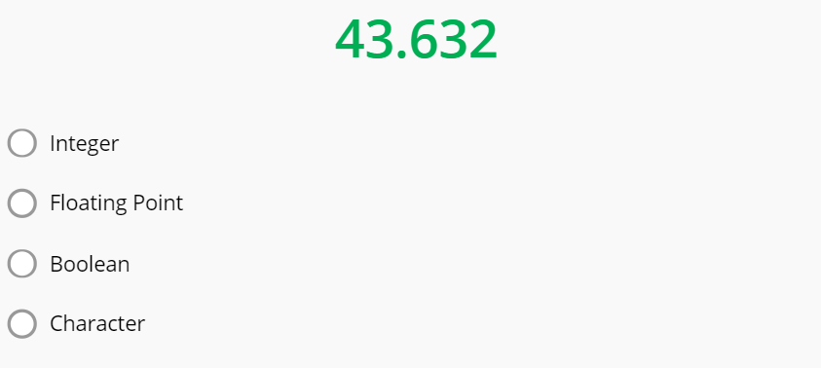
Primitive Data Types Practice
Which primitive data type should you use for the following data:

Slide 11
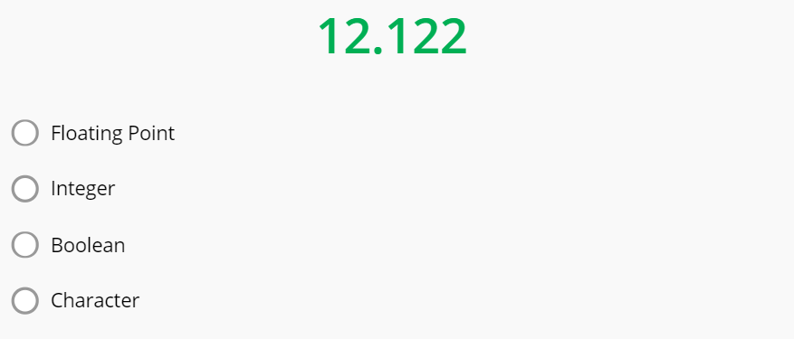
Primitive Data Types Practice
Which primitive data type should you use for the following data:

Slide 12
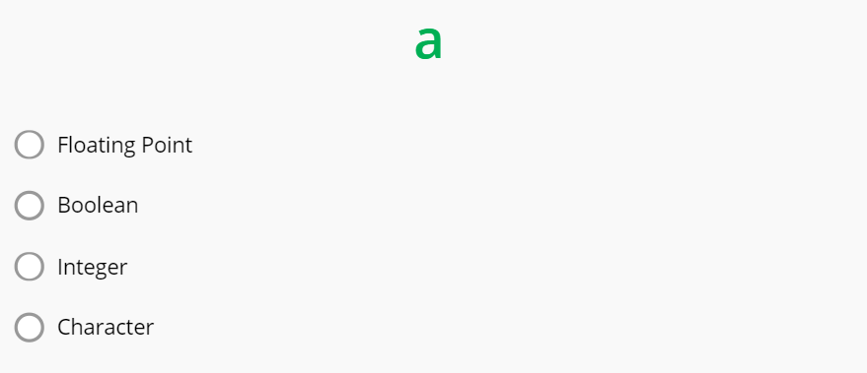
Primitive Data Types Practice
Which primitive data type should you use for the following data:

Slide 13
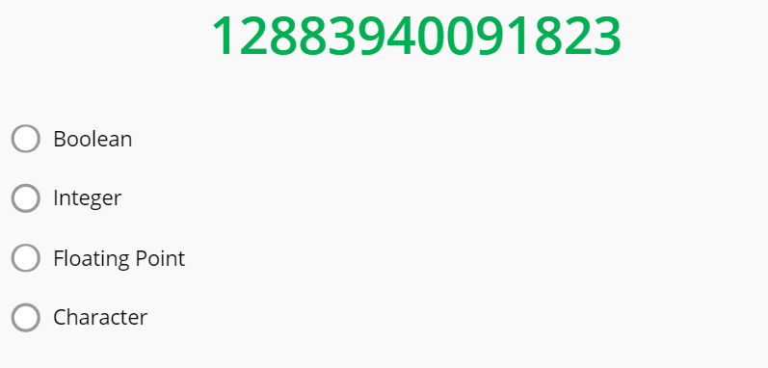
Primitive Data Types Practice
Which primitive data type should you use for the following data:

Slide 14
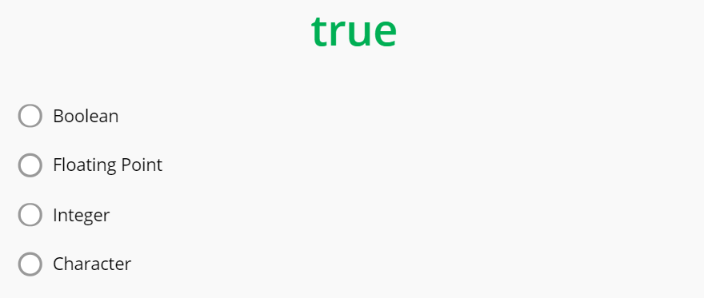
Primitive Data Types Practice
Which primitive data type should you use for the following data:

Slide 15
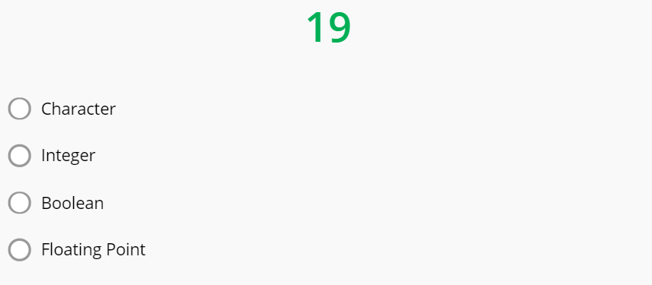
Primitive Data Types Practice
Which primitive data type should you use for the following data:

Slide 16
Primitive Data Types Practice
Which primitive data type should you use for the following data:

Slide 17
Summary
Variables store data of different types.
The basic types Processing uses are Primitive Data Types. They are:
Booleans (true or false)
Integers (whole numbers)
Floating Point Numbers (numbers with a decimal)
Characters (a single character)
You can declare variables using the syntax:

