Slide 1
Processing Basics

Slide 2
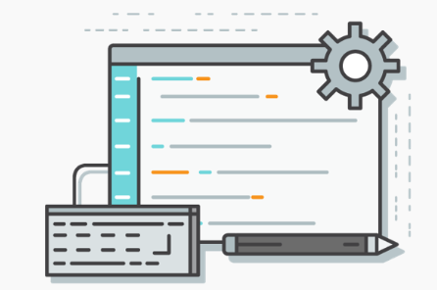
What is Source Code?
Source Code is a special kind of written document through which a programmer can control a computer.
Most source code is simply text made of letters, numbers and symbols.

Slide 3
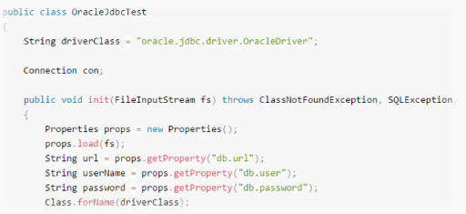
What is Source Code?
Source Code can usually be viewed and edited using any text-editor.
It is sometimes helpful to use an Integrated Development Environment (IDE), a program that allows you to both edit and run your source code.

Slide 4
Source Code
Processing programs are called Sketches and are composed of one or more source code files.
We can run and edit these sketches using the Processing IDE called PDE (Processing Development Environment).

Slide 5
Syntax
The Syntax of a computer language is the set of rules that defines the combinations of symbols that are considered to be correctly structured for that language.
Things like keywords such as the keywords true, false, and null are part of a language Syntax.
Other rules, like ending a statement with a semicolon (;) are also part of a language Syntax.

Slide 6
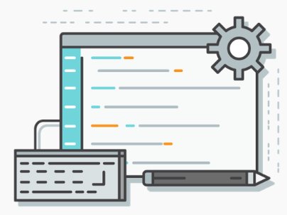
Parts of Processing Source Code
Processing Source Code is made up of many different parts including:
Comments
Statements
Expressions
Methods/functions
White Space

Slide 7
Statements
Statements are the sentences of code. They can perform many different actions.
All statements end in a semicolon (;)
An example of a statement is:

Slide 8
Statements
This statement performs the action of writing Hello World to the terminal.
Try it yourself in Processing and click the Play button to run your code:

Slide 9
White Space
In many programming languages, Processing included, the amount of white space between elements of a program can be arbitrary.
These two programs will perform the same actions:

Slide 10
White Space
While Processing ignores white space, we want our source code to be as readable as possible for other programmers.
Because of this, white space should make sense to the program and be easy to read and understand.

Slide 11
Summary
Source Code is a special kind of written document through which a programmer can control a computer.
The Syntax of a computer language is the set of rules that defines the structure of a language.
Statements are the sentences of code. They can perform many different actions. All statements end in a semicolon (;)
White space is ignored by processing but should be used in a way that makes your code readable.

