Slide 1
Loops Basics

Slide 2
What is a loop?
Loops help us do things
Over and
Over and
Over and
Over and
Over again!

Slide 3
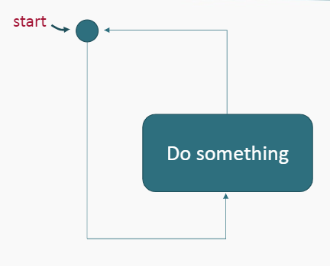
What is a loop?

Slide 4
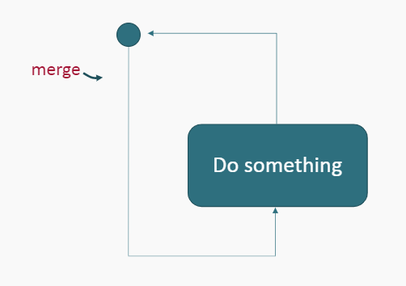
What is a loop?

Slide 5
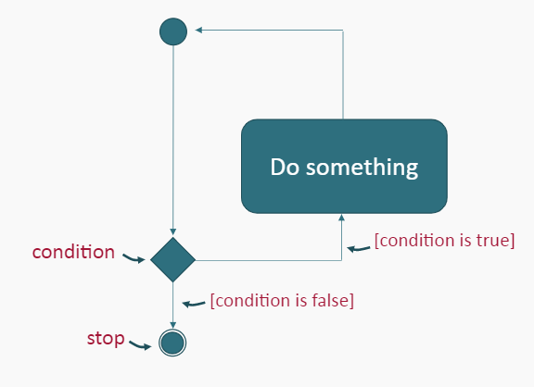
What is a loop?
This loop needs some kind of condition to tell it when to stop.

Slide 6
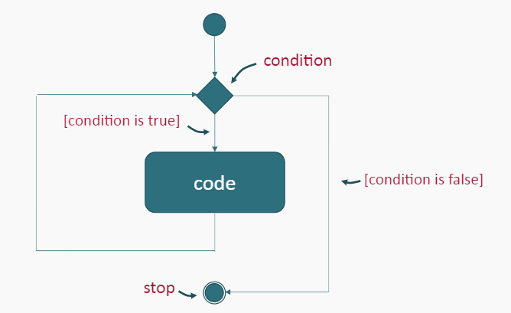
Pre-test Loops
In a pre-test loop, the condition is tested before the code in the loop is run for the first time.

Slide 7
Pre-test Loop Example
Create a diagram for a program that:
Asks the user for a rating between 1 and 5.
For each of the rating points entered by the user, print out a star symbol.

Slide 8
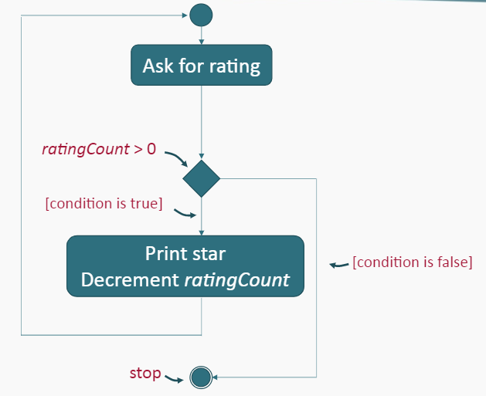
Pre-test Loops Example Solution

Slide 9
Sentinel Values
A Sentinel Value is a special value used to terminate a loop.
You typically choose a sentinel value as something that is not legitimate data value while the loop is iterating.
In the loop that asks the user for a correct password, the sentinel value would be the value of the correct password This is the value which causes the loop to terminate.

Slide 10
Accumulators
An Accumulator is a variable that accumulates the values of data in a program. Accumulators are typically used for counting and totaling.
Accumulators can be incremented with any of the following statements:

Slide 11
Summary
In a Pre-test Loop, the condition of the loop is tested before the code is run for the first time.
A Sentinel Value is a special value that is used to terminate a loop.
An Accumulator is a variable that accumulates the values of data in a program. Accumulators are typically used for counting and totaling

