Slide 1
Boolean Expressions

Slide 2
Boolean Data Type
Remember that the Boolean data type can hold two different values:
We can use Boolean values to make decisions

Slide 3
Expressions in Processing
An Expression is a combination of values, variables and operators that Processing computes to produce (return) another value.
The processing of an expression is called Evaluation
Expressions are Evaluated to Return a value.

Slide 4
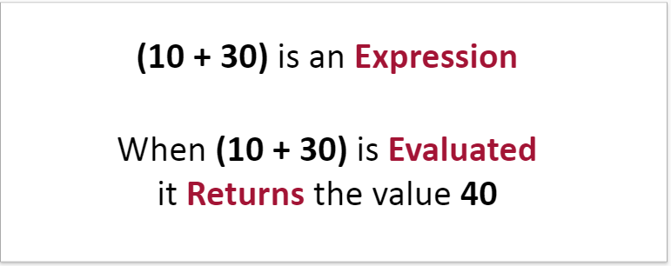
Expressions Example
For example:

Slide 5
Boolean Expressions
Boolean Expressions are expressions that, when evaluated, return Boolean values, either true or false.
For example, the expression:
Would return the value true because 50 is less than 100.

Slide 6
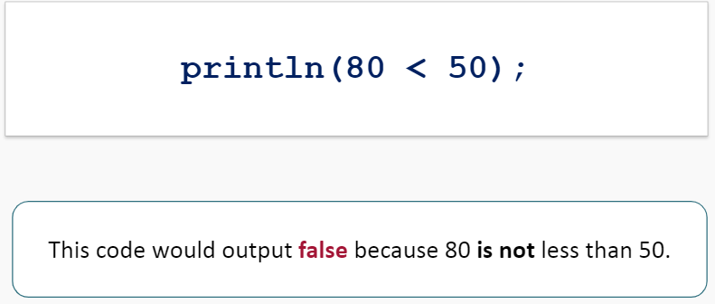
Boolean Expressions
What would be the output of the following code?

Slide 7
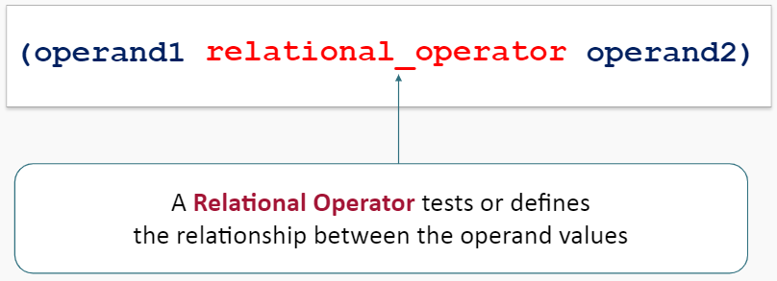
Boolean Expression Syntax
Boolean Expressions use the syntax:

Slide 8
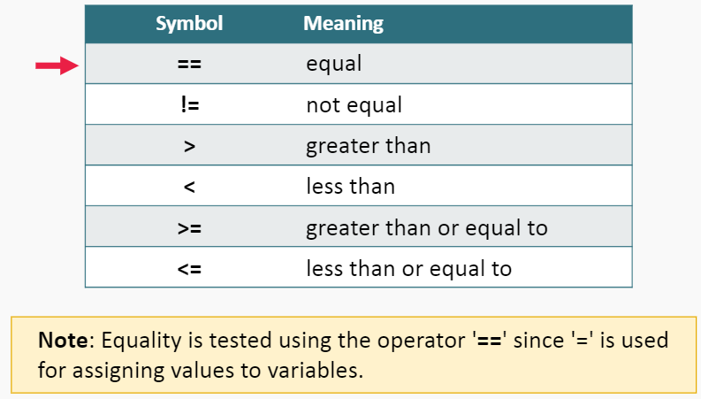
Relational Operators
Boolean Expressions contain the following Relational Operators:

Slide 9
Boolean Expression Examples

Slide 10
Boolean Expression Practice
What is the output of the following code snippet?

Slide 11
Boolean Expression Practice
What is the output of the following code snippet?

Slide 12
Boolean Expression Practice
What is the output of the following code snippet?

Slide 13
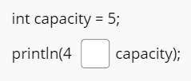
Boolean Expression Practice
Fill in the blank fields in the code snippet below so that the code outputs true

Slide 14
Boolean Expressions
Operands can be any of the primitive data types. Strings and other objects cannot be compared using relational operators.

Slide 15
Expression as Operand
When using an expression as an operand, the expression is evaluated before doing the comparison
The expression is evaluated first: (10 - 5) = 5
The program then checks to see if 5 is les than 6.
This expression would evaluate to true.

Slide 16
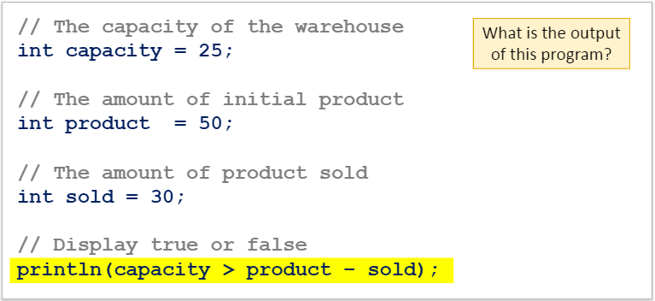
Expression as Operand Example
A warehouse has a capacity of 25 boxes. This program displays false if the warehouse is above capacity and true if the warehouse is below capacity:

Slide 17
Expressions as Operand Example
This program outputs the value true:
This statement first evaluates the expression
product – sold (50 – 30 = 20)
It then checks to see if 25 is greater than 20 which evaluates to true.

Slide 18
Expressions as Operand Practice
What is the output of the following code snippet?

Slide 19
Expressions as Operand Practice
What is the output of the following code snippet?

Slide 20
Expressions as Operand Practice
What is the output of the following code snippet?

Slide 21
Expressions as Operand Practice
What is the output of the following code snippet?

Slide 22
Expressions as Operand Practice
What is the output of the following code snippet?

Slide 23
Expressions as Operand Practice
What is the output of the following code snippet?

Slide 24
Evaluating Boolean Values
A Boolean variable can only be one of two values; true or false. Since the value of the variable is already a Boolean, we do not evaluate Boolean variables in Boolean expressions.
For example:
This code will output true if however it is redundant because isDone is already true.

Slide 25
Evaluating Boolean Values
Instead, we can write this code:
In this example, the code outputs the value of the Boolean variable (true) instead of evaluating it in a Boolean expression.
The code outputs the same true value but it is simpler and easier to read.

Slide 26
Assigning Boolean Expressions
Boolean variables can be assigned Boolean expressions.
For example, the code:
Will output the value true.

Slide 27
Evaluating Boolean Values
By naming Boolean variables this way, you can easily understand the meaning of it. It will also make your program more readable.
For example:

Slide 28
Summary
Expressions are Evaluated to Return a value.
Boolean Expressions return either true or false and use the syntax:
Some common relational operators include: >, <, ==, >=, <=, !=
Operands can be expressions and expressions are evaluated before any comparison is done.

