Slide 1
Applying Information and Communication Tech I
Spreadsheets Intro

Slide 2
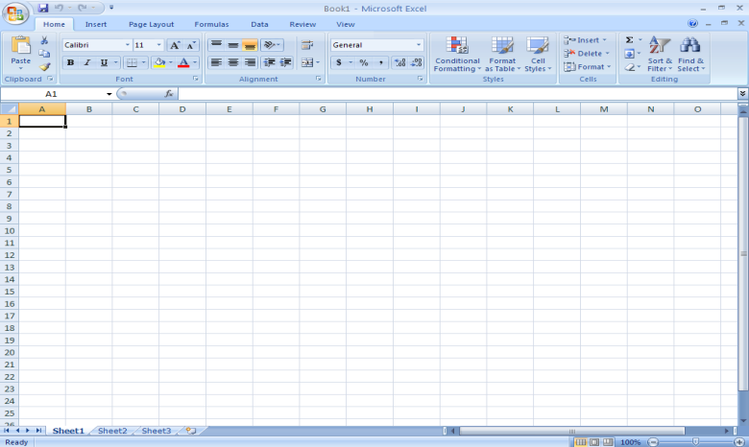
Spreadsheet Window
Ribbon
Formula
bar
Cells
Headings – Numbers for Rows, Letters for Columns
Worksheet tabs

Slide 3
Terms
Label
Text in the first row or column that identifies the type of data contained there
Blank workbook
Contains 3 sheets or tabs

Slide 4
How-to
Make corrections:
Use the mouse to select a cell; double click if necessary
Undo/Redo
Ctrl+Z/Ctrl+Y

Slide 5
How-to
Arrange workbooks
Go to View>Arrange
Select the desired option
Tiled
Horizontal
Vertical
Cascade
Insert or Delete a Cell/Column:
Right-Click on the cell number or column letter, then choose insert or delete.
Resize a row or column:
Click on the line that divides columns or rows and drag.

Slide 6
How-to
Autocomplete
Just type something that has been typed before!
Autocorrect
Main idea – to repair mistakes
Great for speeding up data entry
Can use abbreviations
Also can enter symbols: i.e., © is actually keyed as (c)
Date: Ctrl+:

Slide 7
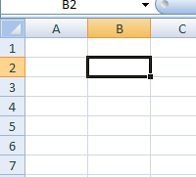
How-to
Check your spelling
Press the “F7” key
Use the “Fill Handle”
Drag it to copy and paste whatever is in a cell

Slide 8
Practice
Complete the following assignments, found in the Assignment Pickup/AC1 folder:
Intro Assignment 1
Intro Assignment 2

